Slide 1
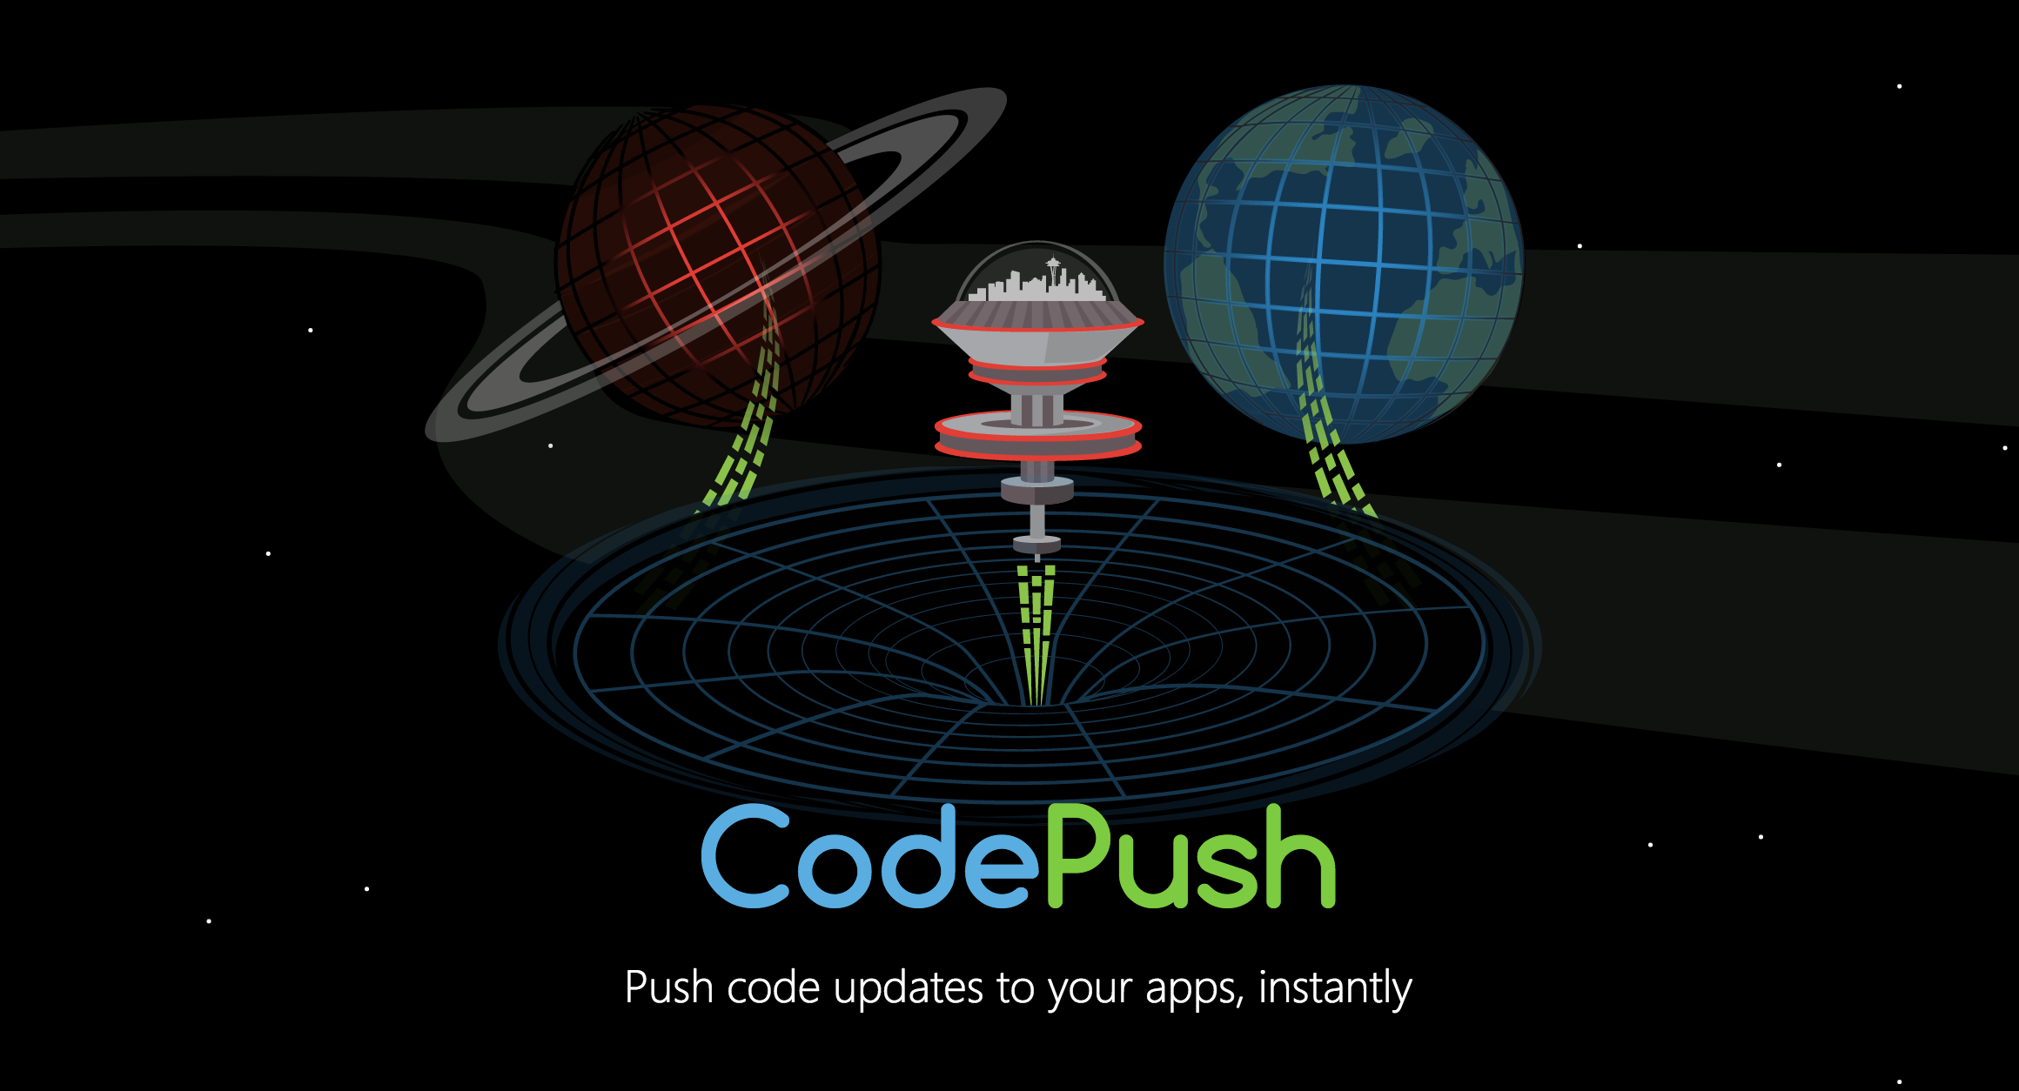

CodePush Technology Introduce
By Richard Jiang

Slide 2

Hot Update For Hybird Application
It is difficult to debug and testing on real device.
It is not easy to update App version.
It is not able to rollback last version.

Slide 3

Why is CodePush?
Open source from Microsoft.
Have a good performance.
Release any files(eg. Image, js, css)
Support rollback last version.
http://microsoft.github.io/code-push/index.html#getting_started

Slide 4
Setup the environment
Install CodePush CLI
Create Codepush account

Slide 5
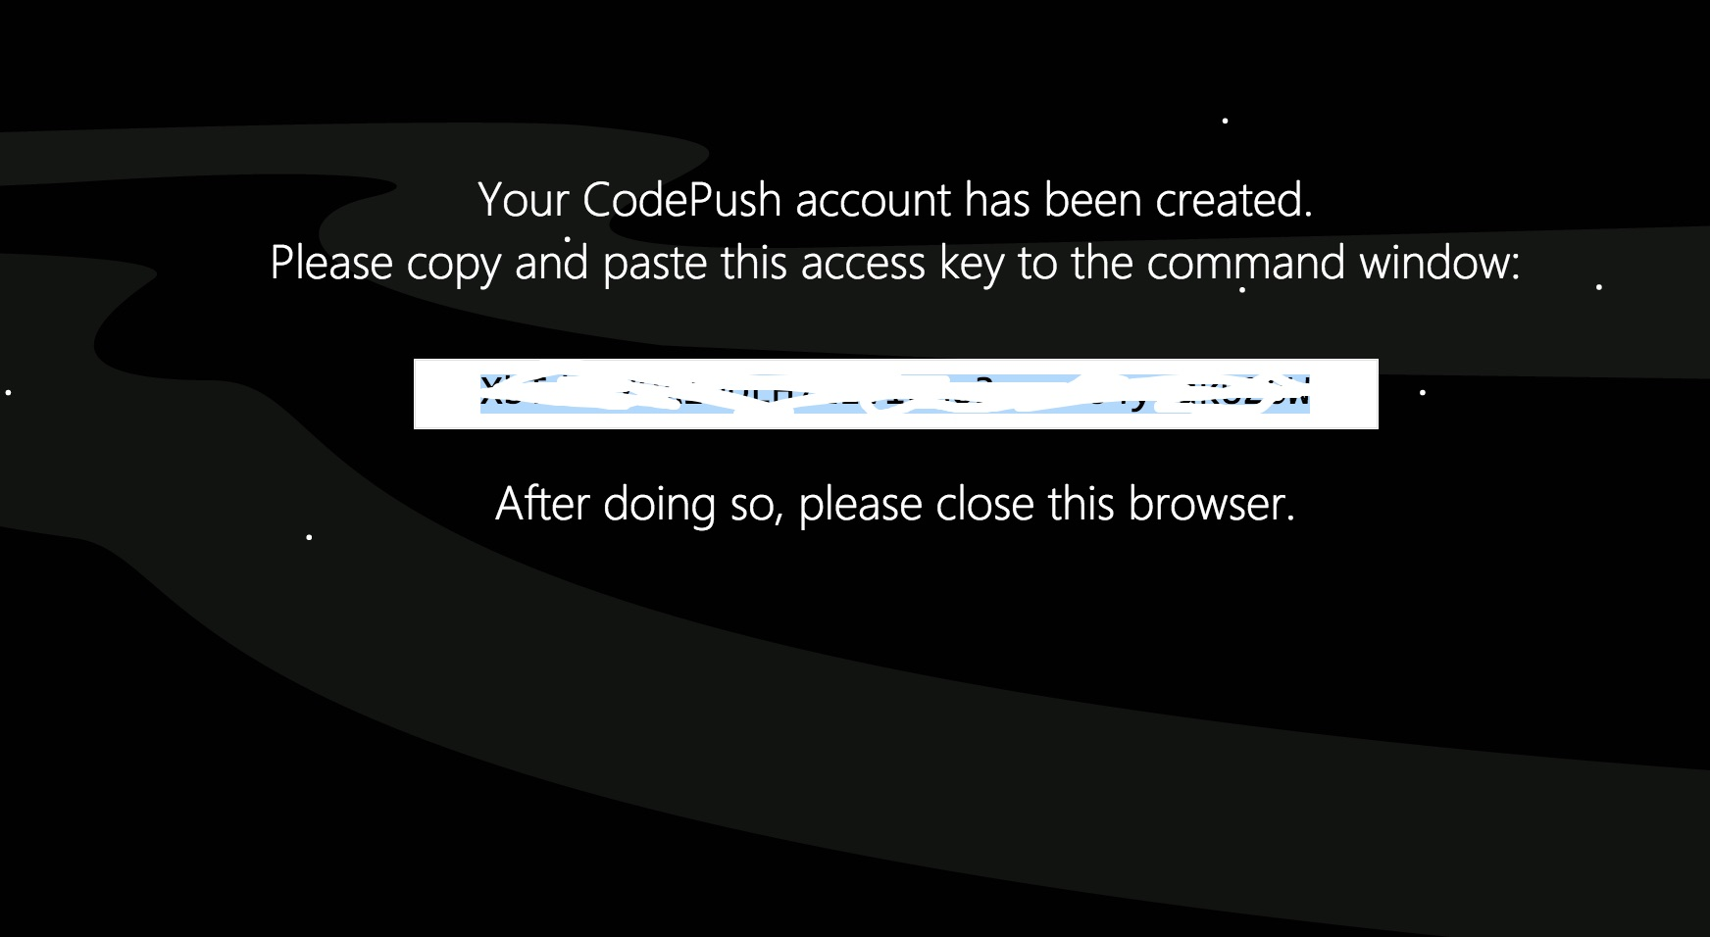
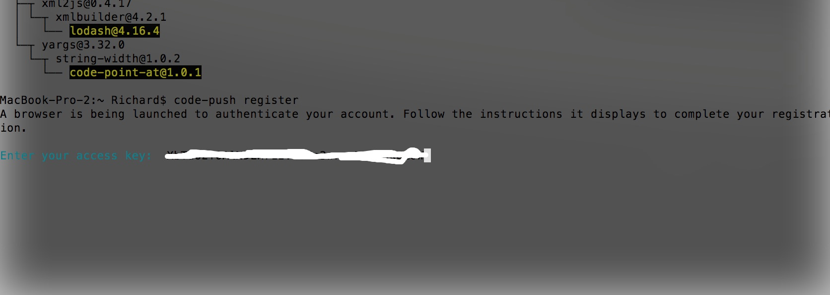

Slide 6
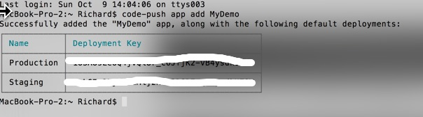
Create App In CodePush Cloud Service
code-push app add <appName>
For example：
code-push app add MyDemo

Slide 7
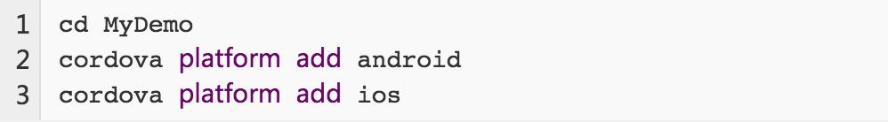
Create test cordova project
Create project
Add platform:

Slide 8
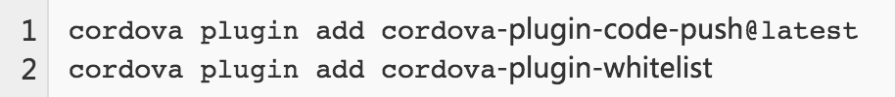
Add Plugin
Note: whitelist plugin is only for android access internet,
code-push plugin is for hot update.

Slide 9
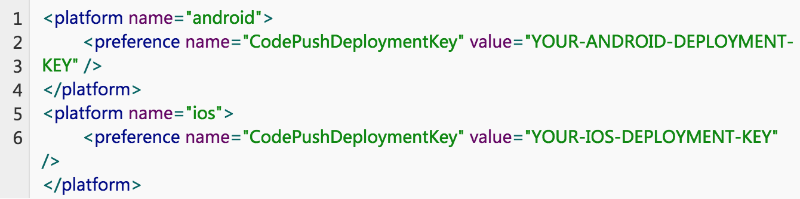
Configure deployment keys
Note: you also can did it like this, code-push deployment ls APP_NAME -k

Slide 10
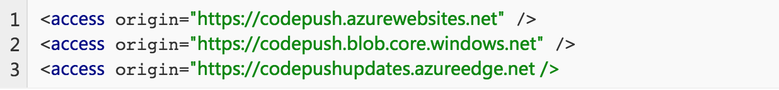
Configure access permissions.

Slide 11
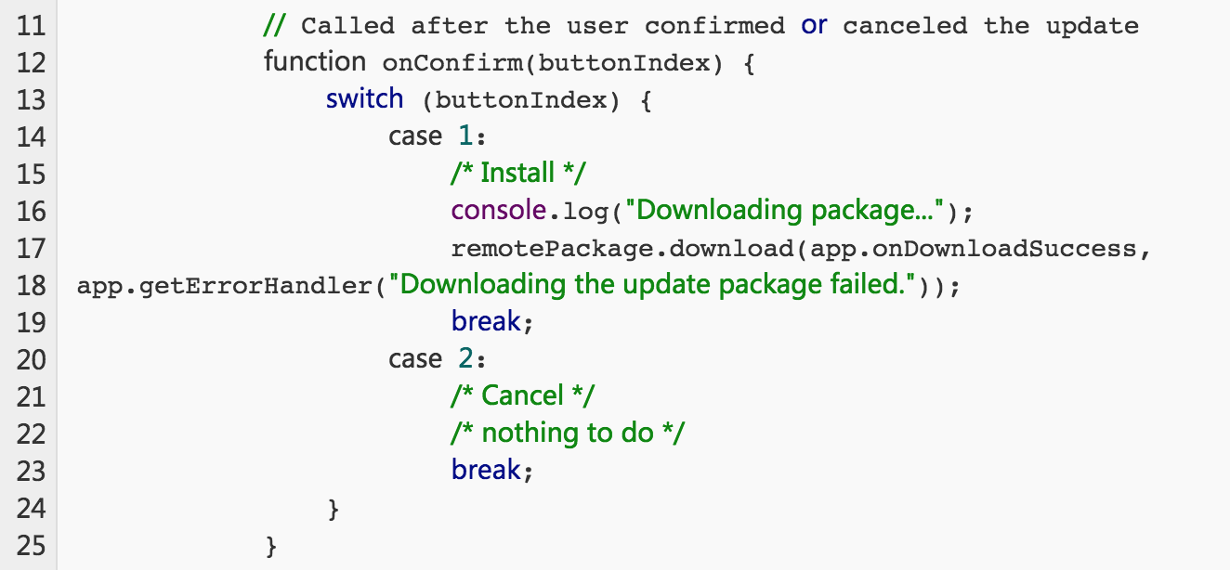
To execute check update.

Slide 12
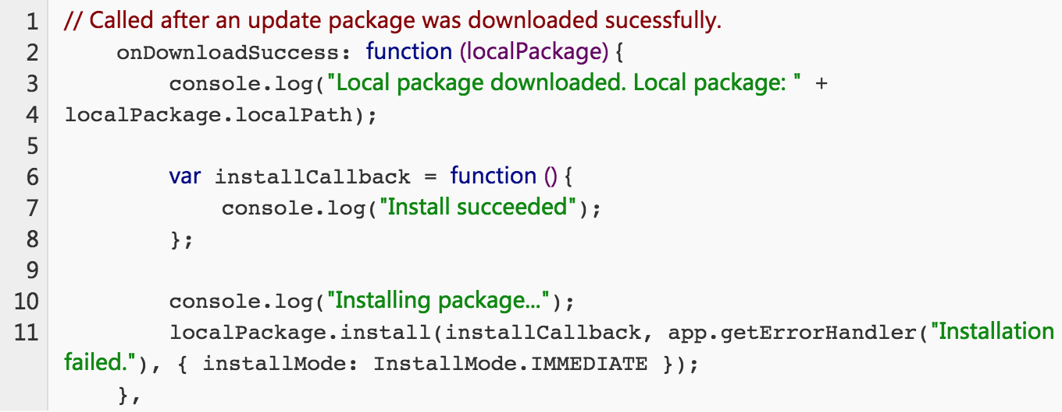
Install the latest packages on device

Slide 13
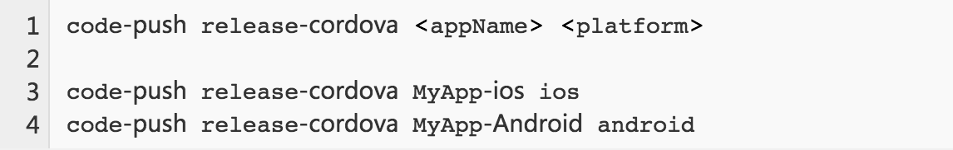
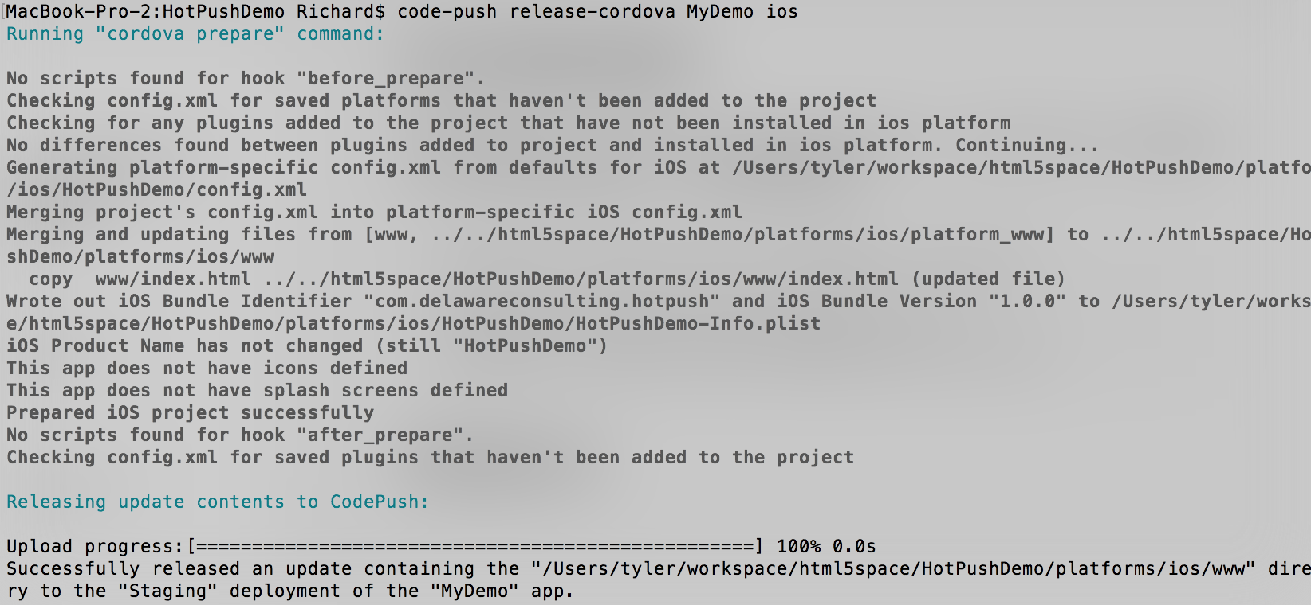
Release the app version

Slide 14
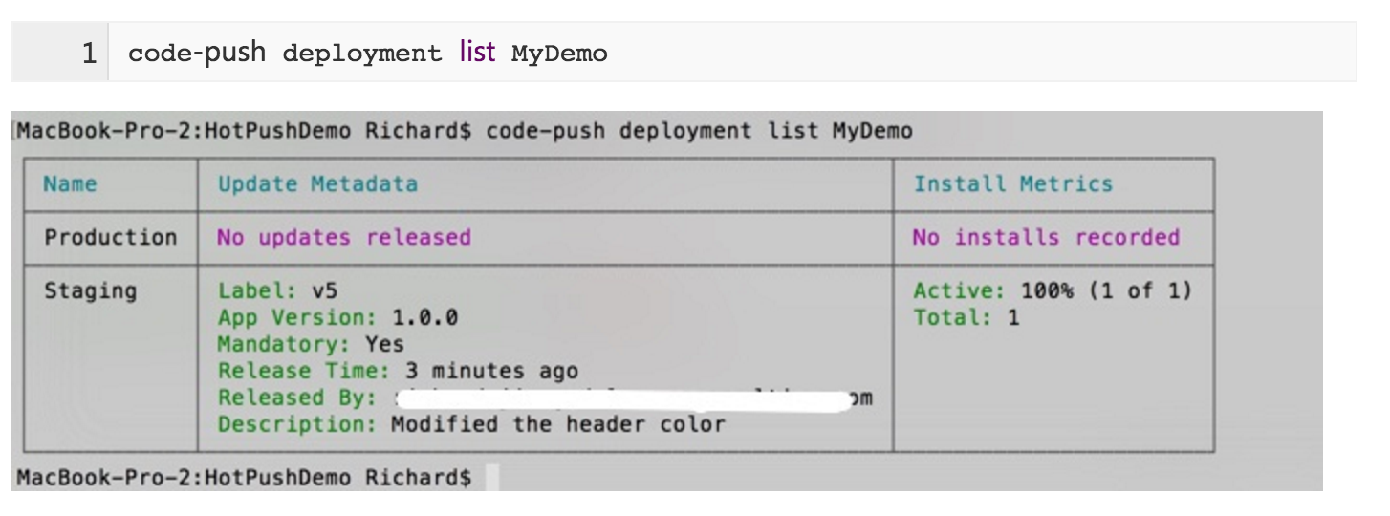
General Command

Slide 15
General Command
To add the description for release:
To check all apps for current account:
To rollback the last version:

Slide 16


